Slide 1

Introduction to R -2
Data exploration

Slide 2
Recap (1)
R is made up of the base language + many useful packages
Types of data; numeric/character/factor/logical
What data frames and vectors are:
Vectors are a string of data i.e “a, b, c” or “2,4,6”
A data frame is a collection of vectors, with column and row names for each vector e.g participant IDs as rows, metadata as columns
1
2
3
4
1
2
3
4
1
2
3
4
1
2
3
4
“a”
“a”
“c”
“f”
1
2
1
4
T
F
T
T
1
2
Vectors
3
Data frame
Notes:
Ask if anyone want’s this clarified before we begin
(More detail on excel)

Slide 3
Recap (2)
How to import and save our data from excel: read.csv(), write.csv()
How to view our data: View() or str ()
Subsetting data:
dataframe$col_name
dataframe[R,C] e.g [3,4]
dplyr e.g select(dataframe, “col_name")
Pipe %>% pass your data frame/object thru multiple functions
dataframe %>% select(“col_name”) %>% filter(percent_cv <20)

Slide 4
Topics for today
Data set up
Manipulating data with dplyr package
Introduction to plotting
Notes:
How we can use a well set up dataframe to make plotting easier ☺

Slide 5
Data transformation (Excel)
Summary calculations done across rows or at the end of columns
Wide format common (only one row per sample, with multiple observations)
Notes:
Touched on last week but didn’t go into great depth I think Show differences between Excel and R layout
If you use excel well, you probably don’t do what I do and will find the transition to R easier
Plate format sometimes needs to be arranged so I can do calculations across cells, and then summarise columns or rows using formula
1) Sample IDs + observations (in our case Vi-IgA concentration) > then formatted to make a table so I can do my calculations (not v efficient)

Slide 6
Data transformation (R)
Long format - one row per observation, multiple rows per sample
(Typically) works well straight from experiment output files
Extra information about the sample can be added later as columns e.g time point, concentration, replicate
Makes joining meta data eventually easier, i.e sample/participant sex, age, BMI, or data measured previously for that sample from other experiments
Notes:
In our case, the observation is the concentration of the sample
Worth setting up in the long run ☺

Slide 7
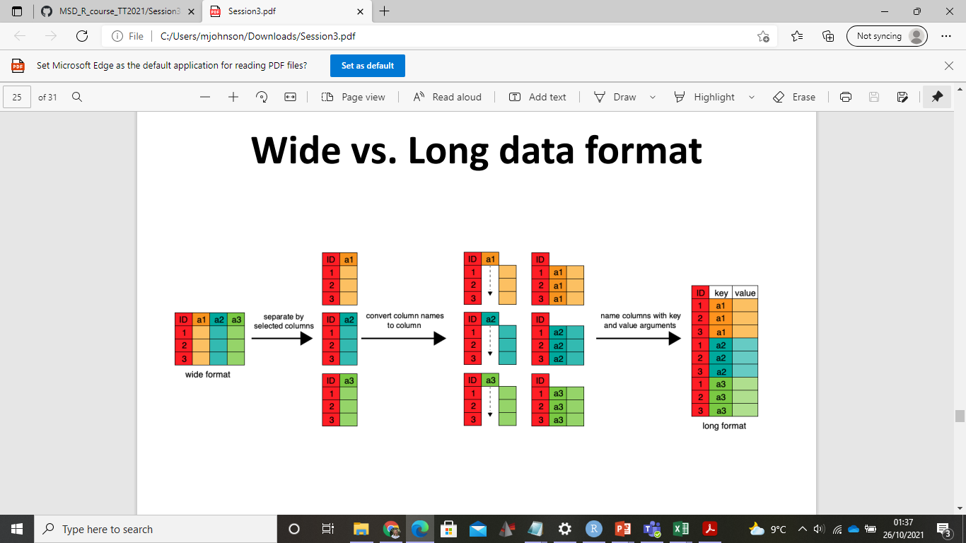
Wide vs Long format data
I try to set up my data in excel as long format data when I can
However you can convert between the two using R ☺
dcast/melt or gather/tidy https://ademos.people.uic.edu/Chapter8.html
http://www.sthda.com/english/wiki/tidyr-crucial-step-reshaping-data-with-r-for-easier-analyses
Notes:
You need to know what ‘key’ you are splitting them by
Data in csv is already in long format – good habit when getting data

Slide 8


Explore in R

Slide 9
Summarising data (1)
In excel we use formulae to summarise data at the end of tables
In R we can also summarise our data, save it as a separate object using (<-)
Or add a new column to the data frame using dplyr:mutate
Notes:
Short term, it is easier in excel, long term it is much faster in R > more possibilities to plot and analyse your data
Like in Excel you can perform calculations, the difference being instead of appending them we save them as a data frame

Slide 10
Summarise – Find the mean
We can summarise data most simply by subsetting either a column or row
Base R uses functions such as mean() to calculate averages
E.g. mean(dataframe$colname)

Slide 11
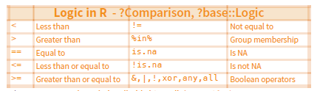
Summarise – Logical conditions
We can also filter columns and rows based on logical conditions
For example if I wanted to find the mean antibody concentration for one time point
1) subset column of interest, 2) then subset condition using []
Notes:
e.G trying to find the average of just pre-purification

Slide 12
Explore in R

Slide 13
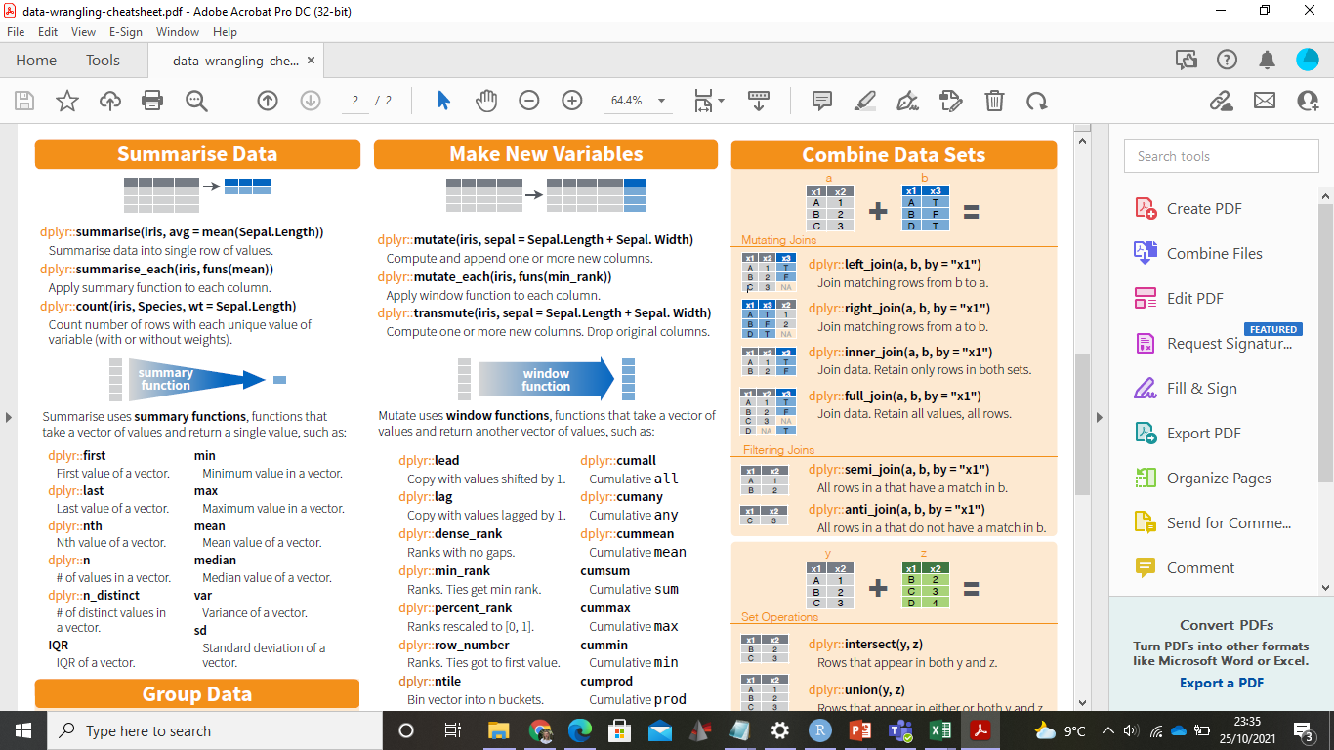
Summarise data (2)
In dplyr, we can subset rows using filter() or group_by() functions
Pipe %>% filtered table into summarise function
Pick operation to perform
E.g data %>% filter(condition == TRUE) %>% summarise(average = mean(colname))
Notes:
Lots of functions you can try
Summarise mean, sd etc.

Slide 14
Explore in R

Slide 15
Mutate new column
Often we want to calculate a new variable, such as percentage CV or fold change
In my data, I would like to calculate the amount of Vi IgA antibody purified, and the percentage of Vi IgA purified
Steps:
Subset data frame using [ ] or filter for logical conditions
Calculate new values
Save results as a new column in data frame using dplyr::mutate

Slide 16
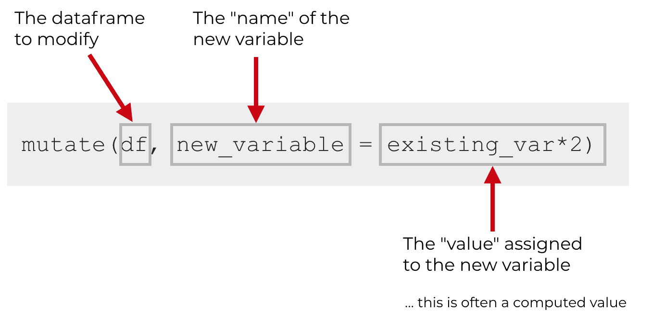
Dplyr mutate
When you use mutate(), you need typically to specify 3 things:
the name of the dataframe you want to modify
name of the new variable that you’ll create
the formula/value you will assign to the new variable

Slide 17
Explore in R

Slide 18
Plotting
http://www.sthda.com/english/wiki/ggplot2-essentials
For plotting data we will use the ggplot package
Plot = data + Aesthetics + Geometry.
data is a data frame
Aesthetics is used to indicate x and y variables. It can also be used to control the color, the size or the shape of points, the height of bars, etc…..
Geometry defines the type of graphics (histogram, box plot, line plot, density plot, dot plot, ….)
Notes:
Now that our data is in good shape and all the variables are computed, we’re ready to try some plotting ☺

Slide 19
Explore in R

Slide 20
Extra slides

Slide 21
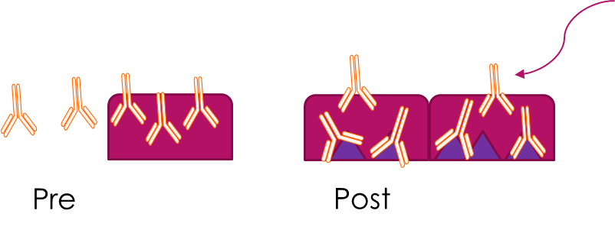
Vi Purification Experiment – Data set
Incubate serum from Vi vaccinated individuals on a Vi (typhoid antigen) coated plate
After the incubation, measure concentration of Vi in supernatant using an ELISA – this is the Vi antibody that we didn’t capture
The difference between pre purification and post purification (supernatant) concentrations is therefore the amount of Vi antibody that has been bound to the plate
ELISA on unbound antibody
Initial Vi IgA concentration measured using ELISA (Pre purification)
Cleave bound Vi antibody with formic acid
Notes:
I’m trying to purify Vi antibodies so we can analyse their glycans in mass spec
First part is to try get as much Vi as possible!
Open up CSV file to see the output is sample IDs and their concentrations which we measured from ELISA

Slide 22
Math operations
Add, subtract, divide, multiply
+ - / *
Modulo (remainder of division)
%%
Exponent
^
Rounding
round(), floor(), ceiling()
Top tip: as you would with excel, remember brackets when writing equations (BODMAS)
Notes:
Like in Excel you can perform calculations, the difference being instead of appending them we save them as a data frame

Slide 23
Plate layouts
Often data outputs across rows (like with flow)
Use paste transform in excel to arrange correct sample IDs next to observations
Option to use plateR package in R

Slide 24
Why long format data
A data set is called tidy when:
each column represents a variable
and each row represents an observation
You can have multiple rows per sample bc they have more than one obersvation e.g pre and post-vaccination

